Slide 1
The webinar for purchasers will begin momentarily
March 23, 12 PM

Slide 2
Agenda
Welcome
Program overview
Eligibility criteria
Basic application process
Administration, documentation, and compliance
Q&A
FINAL DRAFT

Slide 3
NJ ZIP Phase 2 program overview: At a glance
What is NJ ZIP?
The New Jersey Zero-emission Incentive Program, a voucher-style, first come, first served program. In contrast to the limited roll out of Phase 1 (launched April 2021), Phase 2 will bring the pilot to potential purchasers statewide
What is the purpose of this program?
Reduce the upfront cost of buying a zero-emission medium- and heavy-duty vehicles for NJ businesses and institutions, leveraging RGGI funding
How much voucher funding is available?
$45M total, with $15M set aside for small businesses and $15M set aside for overburdened communities
When will applications open?
Tuesday, April 18th, 2023 @ 10AM Eastern

Slide 4
NJ ZIP Pilot: Changes from Phase 1 to Phase 2
Topic | Phase 1 Program | Phase 2 Program
Voucher Budget | $44.25M | $45M
Eligible vehicles | Class 2b – Class 6 | Class 2b – Class 8
Eligible locations | Camden, Newark, New Brunswick, and Shore | Statewide, with EJ community bonuses
Eligible vendors | NJ-registered entity, in good standing 12 months experience Good standing checks No application fee | No change to eligibility, but pays one-time $1,000 fee
Eligible purchasers | NJ-registered commercial or institutional entities Must be vehicle owner & not have prior funding Pays $1,000 app fee (w/ hardship waiver) | No change
Voucher Expires | 6 months with up to 12-month extension | 1 year base with 6-month extension
Voucher Base $ | $25,000 - $100,000 | $20,000 - $175,000
Stackable Voucher Bonuses | Small Business (+25%) NJ manufacturing (+25%) Certified WMVOB (+$4k) Scrappage (+$2k) Driver Readiness (+$2k) | No change to small biz & NJ manufacturing bonus Changed WMVOB from flat $ to % basis (+4%) Removed scrappage & driver readiness bonuses Added EJ Bonus (+10%) Added School bus bonus (+25%)
Caps and set asides | Capped at 100% Vehicle Cost $1.5M per EIN $2M set aside per community $5M set aside for small biz | No change to cap $3M per EIN $15M set aside for EJ communities $15M set aside for small businesses

Slide 5
NJZIP Help Desk – Rutgers VTC
The Voorhees Transportation Center is working with NJEDA to develop and staff a new NJZIP “help desk”
Purpose: To assist purchasers with the application process and provide assistance with planning for electric vehicle ownership.
Live information sessions
Resource website
Webinars
Fact sheets
FAQs
Case studies
Short informational videos
Telephone or Text for personalized help

Slide 6
What kinds of topics we’ll cover:
Personalized Technical Assistance
Determining which vehicles are best suited to meet the business’s needs;
Understanding the costs of purchasing and operating ZE MHDVs;
Identifying what charging infrastructure businesses may need to accommodate their electrification plans,
Fleet operation needs and behavior adaptation.
Procedural Assistance
Navigating the application portal;
Securing businesses certifications and tax clearance certificates;
Understanding requirements for registering and insuring vehicles; and
Reviewing draft application forms for completeness and accuracy.

Slide 7
How to reach us
The help desk will be live starting mid-April 2023 when the application period opens.
Website: https://vtc.rutgers.edu/njzip/
Email: njzip-help@ejb.Rutgers.edu
Phone: (732) 790-0663
Text feature coming soon!

Slide 8
Phase 2 Eligibility: Purchaser eligibility
What customers are eligible for the program?
New Jersey businesses and institutions that are in good standing
+
Purchase new, ZE medium- or heavy-duty vehicle(s) from approved vendor
+
Register vehicle(s) in NJ and operate vehicle(s) 75% VMT or more in NJ for at least 3 continuous years after voucher disbursement

Slide 9
Phase 2 Eligibility: Vendor eligibility
What is an ‘approved vendor’?
A Vendor is a business which sells eligible zero-emission medium and/or heavy-duty vehicles to the purchaser (voucher applicant). Vendors can be approved by the program if they apply and are eligible, by:
Registering to do business in NJ and being in good standing
+
Having at least 12 months of experience with zero-emission vehicles
+
Agreeing to the voucher terms
+
Providing documentation and support to purchaser

Slide 10
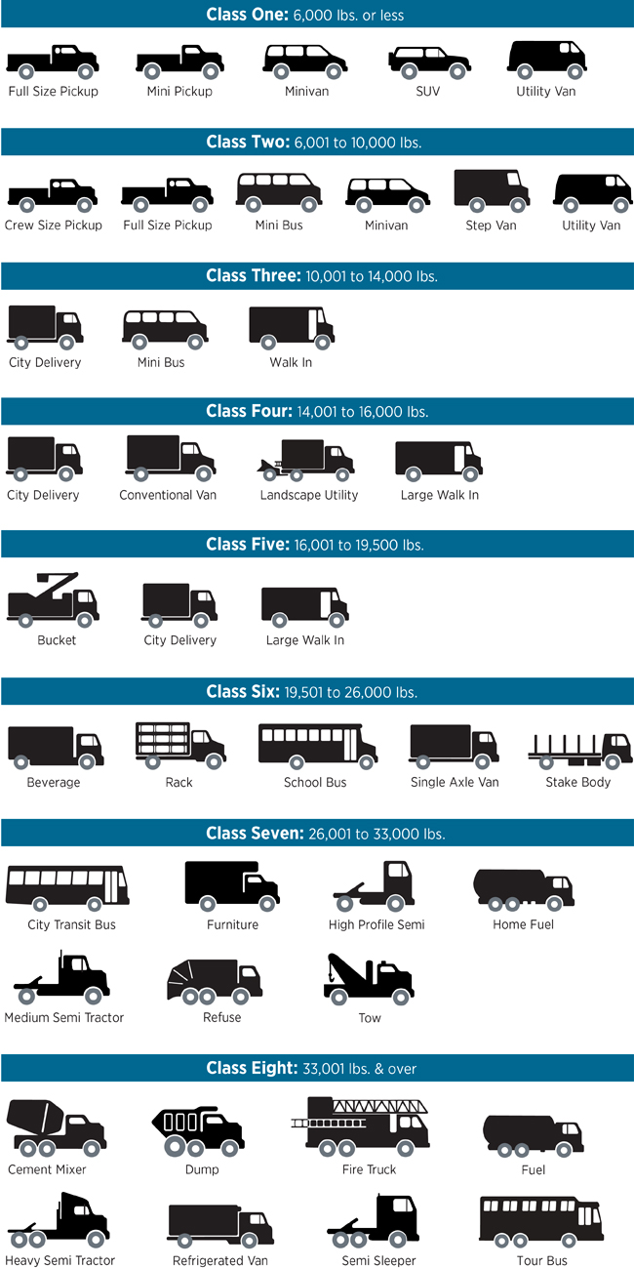
Phase 2 Vouchers: Vehicle eligibility and base values
Examples from FHWA
What are the eligible classes and base voucher?
For Phase 2, any vehicle between Class 2b – Class 8, by weight (GVWR)
Trucks, buses, vans, specialty vehicles, etc. are all eligible in these ranges.
Vehicle Weight | Base Voucher Amount
Class 2b | $20,000
Class 3 | $50,000
Class 4 | $65,000
Class 5 | $75,000
Class 6 | $90,000
Class 7 | $135,000
Class 8 | $175,000

Slide 11
Phase 2 Vouchers: Bonuses
Stackable applicant and vendor bonus criteria
In Phase 2, all bonuses are increased on a percentage basis per vehicle:
Small business bonus: 25% for business with less than $5M annual revenue or 25 employees
Certified woman-, minority-, or veteran-owned business bonus: 4% per qualification
EJ Bonus: 10% for small business applicants or municipalities who commit to drive 50% or more vehicle miles in NJ overburdened communities for 3+ years.
NJ manufacturing bonus: 25% for Vendors that demonstrate 25% or more of the cost of that vehicle is spent in New Jersey on labor for vehicle design, assembly, and/or manufacturing or cost of components.
School Bus Bonus: 25% if applicant is purchasing a school bus

Slide 12
Phase 2 Voucher: Limits and caps
Voucher limits
A voucher, inclusive of any bonuses, is capped at the total cost of the vehicle it is applied to. Charging infrastructure or other costs are not included.
An applicant can apply for multiple vehicles at once, with total reserved voucher amount capped at $3M per applicant EIN for the second phase. Note: Phase 1 awards do not impact eligibility or cap for Phase 2.
All disbursements are subject to appropriations and availability of funding.
Vouchers expire 12 months after approval. A single 6-month extension may be granted if good faith efforts are shown to procure the vehicle in the given time.

Slide 13
Example Voucher Calculation
You are a NJ manufacturer, selling (1) Class 5 vehicle to a woman-owned small business. You quote $210,000 pre-voucher for the vehicle, charging not included.
Voucher amount = ( x ( 1 + ( + + )
Voucher amount = ( $75,000 x (1+ ( 0.25 + 0.25 + .04)
Voucher amount = $115,500
Upfront cost to purchaser = $210,000 - $115,500 = $94,500 with voucher
Base voucher amount
Small business bonus
NJ manufacturer bonus
Woman-owned business bonus

Slide 14
Purchaser application process: Overview
How do I actually apply for vouchers?
Purchaser finds and selects an eligible Vendor and eligible vehicle(s), and procures a quote / contingent PO
Change for Phase 2 Vendor starts voucher application for purchaser, filling out vehicle info and any purchaser-specific deviations from standard docs
NOTE: Access to the purchaser application will be via a single email per purchaser. Ensure you have the right email entered! A dashboard view may be available in addition.
Purchaser receives email notification when Vendor portion is complete. Purchaser completes and submits application and $1000 application fee.
Notes:
1: Purchaser finds and selects an eligible Vendor and eligible vehicle(s)
2: Selected Vendor populates application through vehicle selection..
NOTE: Vendor inputs could include purchaser-specific warranty, delivery of vehicle timeline, charging/fueling information (as available) or plans where not available, implementation of maintenance plan
NOTE: Access to the purchaser application will be via a single email per purchaser, with individual access links per vehicle. A dashboard view may be available in addition.
3: Purchaser receives email notification when Vendor additions uploaded. Purchaser completes and submits application, including entity information, proof of eligibility, and $1,000 application fee.
4: NJEDA reviews application and, if the purchaser, Vendor and vehicle are eligible and funds are available, approves voucher(s), inclusive of qualifying bonuses and sends the Applicant a voucher reservation email. Voucher funds will be reserved for 12 months.
5: Vendor and purchaser execute voucher agreement with NJEDA
6: Within 12 months, Vendor delivers vehicle and purchaser registers vehicle within 12 months of voucher reservation. Purchaser pays purchase price minus full voucher amount, per terms between Vendor and purchaser, outside of voucher program.
7: Purchaser and Vendor submit any outstanding documentation, including proof of registration and proof of scrappage (as applicable).
NOTE: Scrappage is only required for vehicles model year 2009 or earlier which are being directly replaced.
8: NJEDA reviews submission and, if all relevant program agreements have been met, purchaser voucher is assigned to Vendor, who redeems the voucher funds from NJEDA.
Compliance monitoring: As a requirement of the voucher funding, purchaser and Vendor will respond to NJEDA’s audit requests as needed to confirm post-award compliance and inform future program design, for Vendors including but not limited to providing the agreed-to vehicle and related charging/fueling support, providing maintenance facilities, and providing warranty

Slide 15
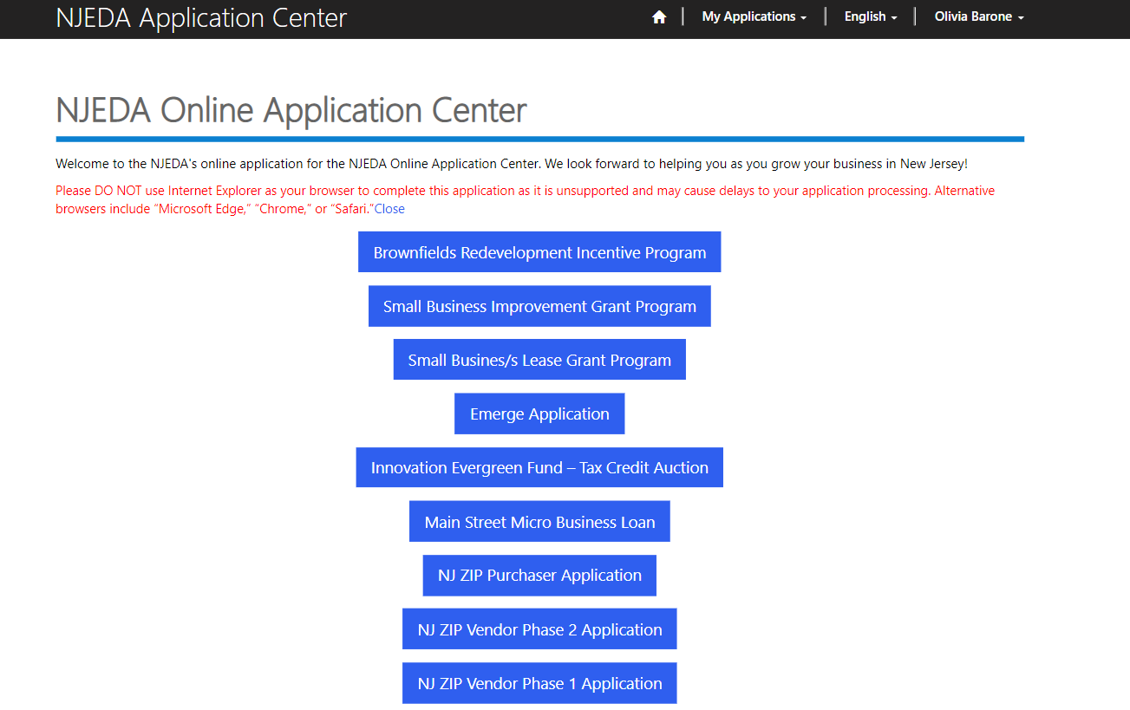
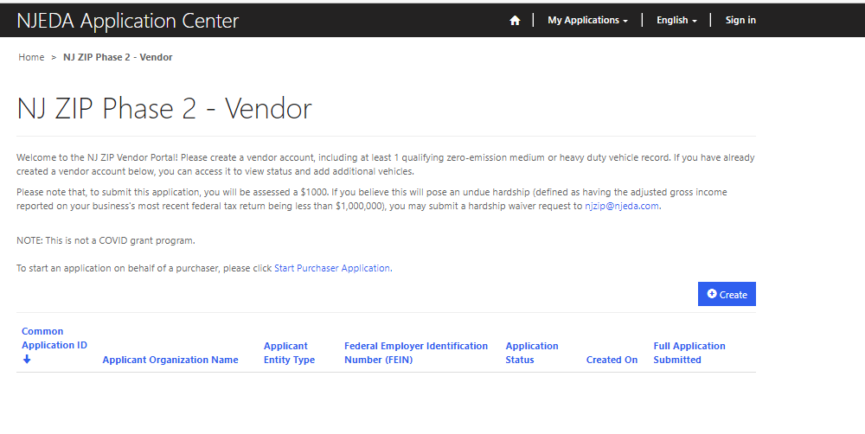
Purchaser application process: Vendor Portion
Start Purchaser application
Populate entity information
Populate vehicle(s) information
Upload documents
Submit to Purchaser

Slide 16
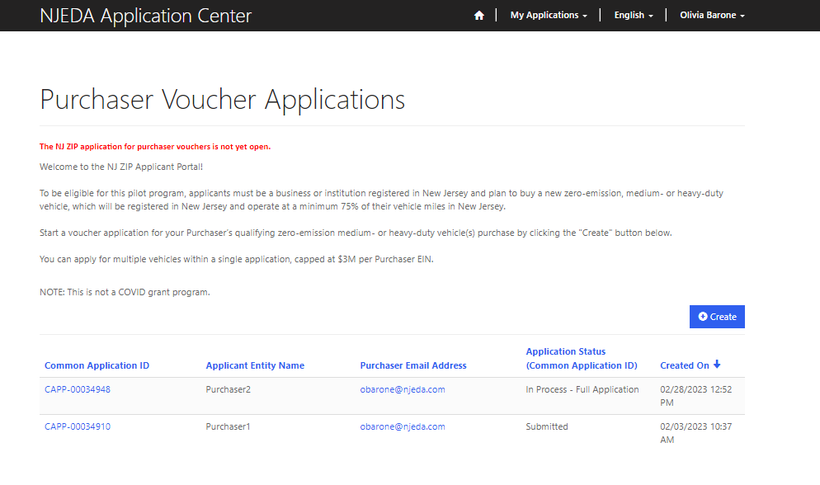
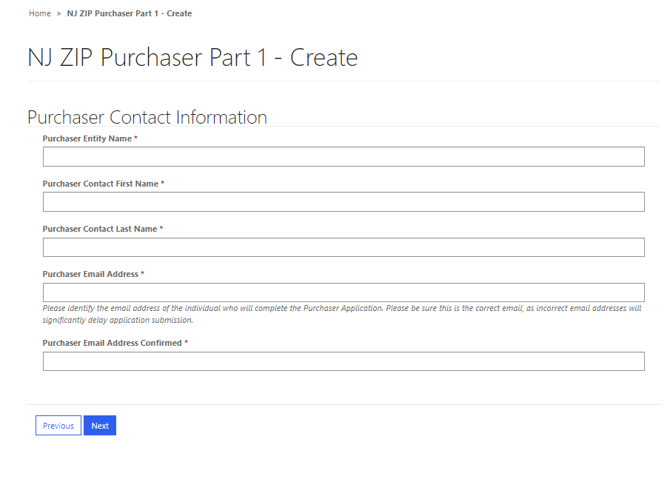
Purchaser application process: Vendor Portion (con’t.)
Start Purchaser application
Populate entity information
Populate vehicle(s) information
Upload documents
Submit to Purchaser
Access to the purchaser application will be via a single email per purchaser. Ensure you have the right email entered! A dashboard view may be available in addition.

Slide 17
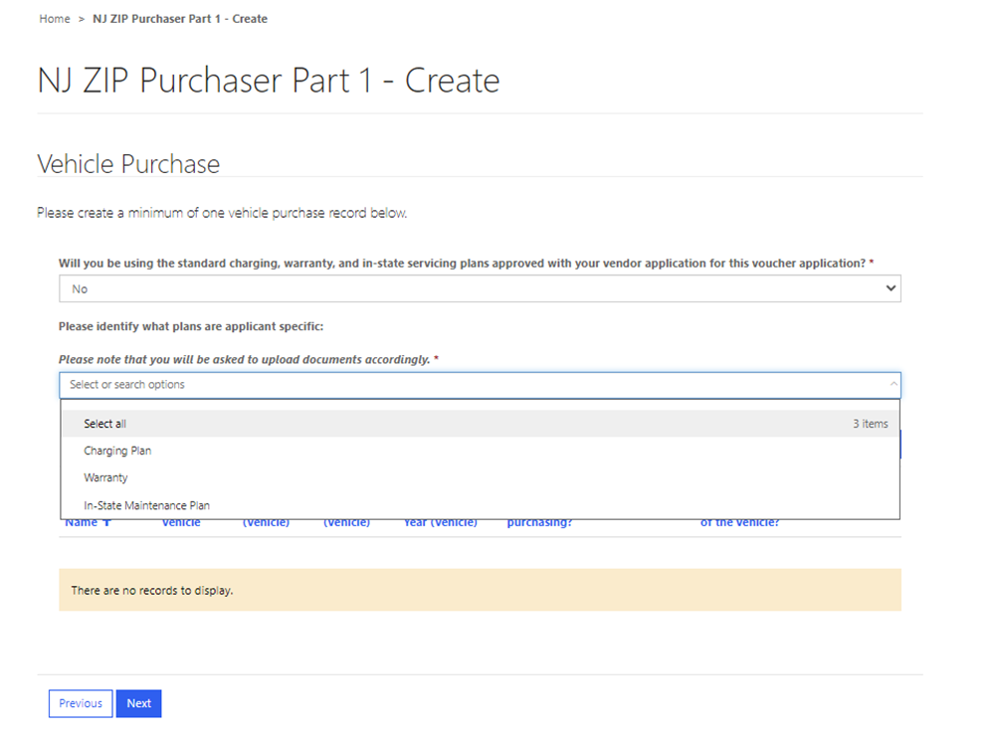
Purchaser application process: Vendor Portion (con’t.)
Start Purchaser application
Populate entity information
Populate vehicle(s) information
Upload documents
Submit to Purchaser
What do I need for Purchaser Application?
Proof of intent to purchase (signed quote or contingent PO) Any deviation from standard documents: Purchaser specific in-state maintenance plan Purchaser specific vehicle warranty Purchaser specific charging plan Vehicle Delivery Plan

Slide 18
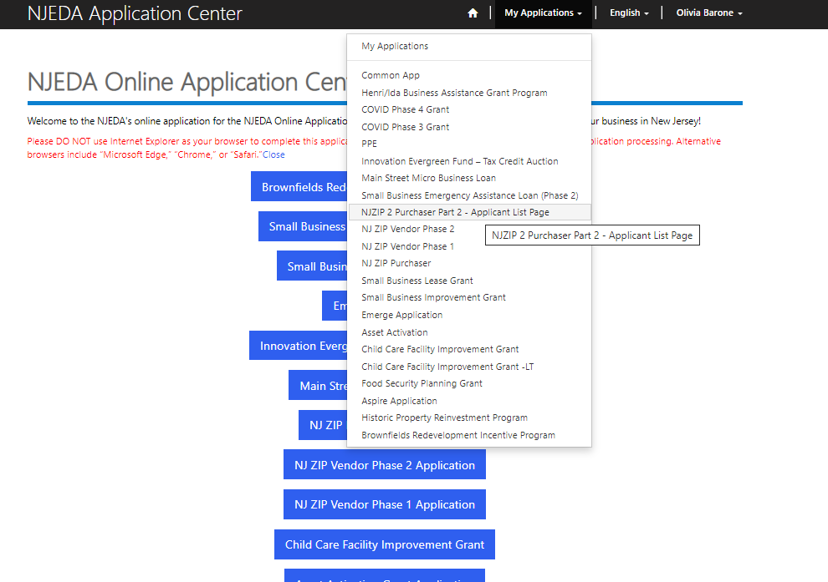
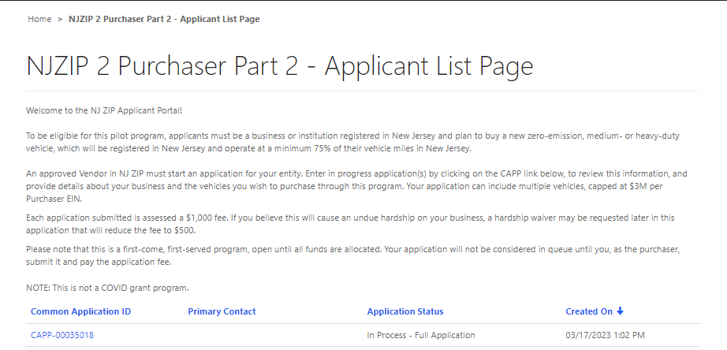
Purchaser application process: Purchaser Portion
Start Purchaser application
Populate entity information
Populate vehicle(s) information
Upload documents
Pay fee and submit
Reviewed & approved for participation
Status meaning:
In Process: with the vendor
In process full application: with the purchaser
Submitted

Slide 19
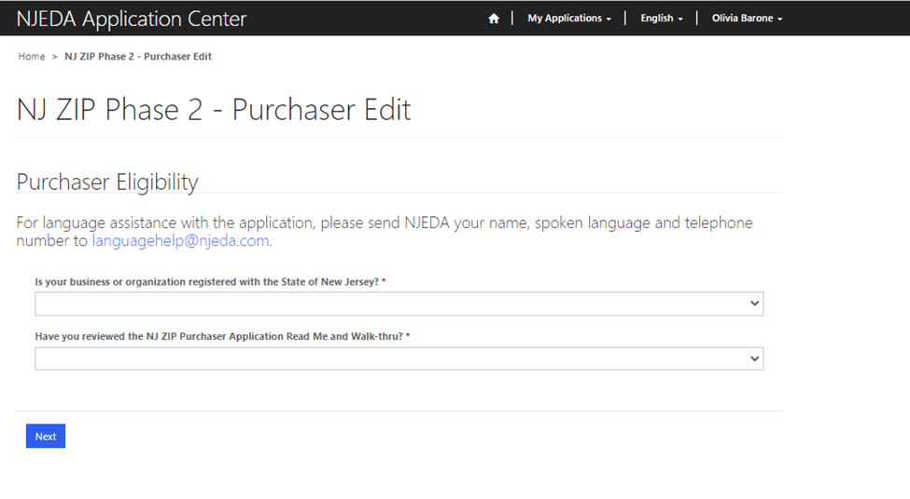
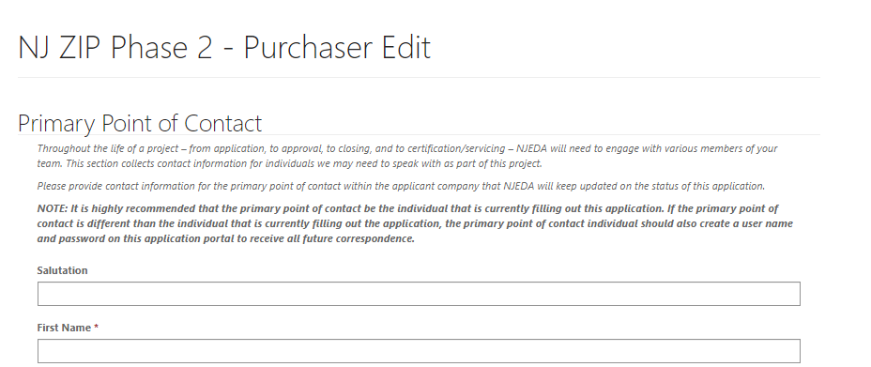
Purchaser application process: Purchaser Part (con’t)
Start Purchaser application
Populate entity information
Populate vehicle(s) information
Upload documents
Pay fee and submit
Reviewed & approved for participation
Entity information includes: name, address, contact(s) information (primary contact, CEO, & any others), EIN, website, business description, demographics/diversity plan, legal questionnaire, etc
Notes:
Authorized purchaser signatory completes legal debarment questionnaire
For a corporation, by a principal executive officer, at least the level of VP;
For a partnership, by a general partner;
For a sole proprietorship, by the proprietor;
For a gov’t entity, by contact person (administrator, manager, mayor, etc.);
For other than above, the person with legal responsibility for the application

Slide 20
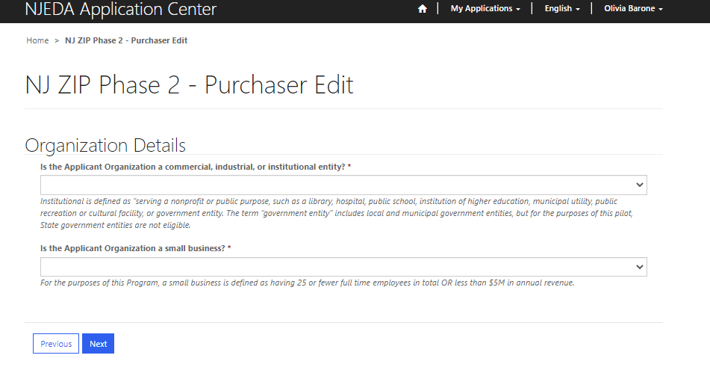
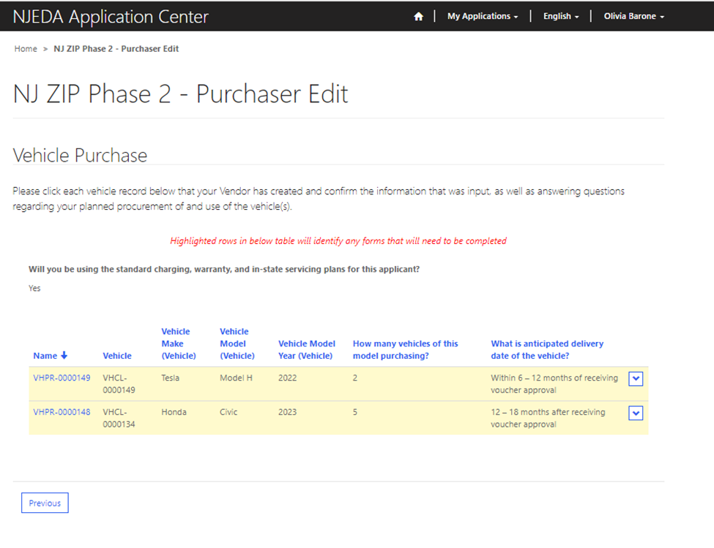
Purchaser application process: Purchaser Portion (con’t)
Start Purchaser application
Populate entity information
Populate vehicle(s) information
Upload documents
Pay fee and submit
Reviewed & approved for participation

Slide 21
Purchaser application process: Purchaser Portion (con’t)
Start Purchaser application
Populate entity information
Populate vehicle(s) information
Upload documents
Pay fee and submit
Reviewed & approved for participation
What your vendor submitted | What you need to submit
Proof of intent to purchase (signed quote or contingent PO) Any deviation from standard documents: Purchaser specific in-state maintenance plan Purchaser specific vehicle warranty Purchaser specific charging plan Vehicle Delivery Plan | NJ tax clearance certificate, including registered to do business Minority-,Women-, Veteran- Owned Businesses certification (if applicable) Proof of location in which you will be registering and primarily operating the vehicle Small business documentation (if applicable) Staff Count, Tax documented staff count, as appropriate to company type: e.g., Federal 941, WR-30, etc. Annual Revenue, Tax documented revenue, as appropriate to company type: Federal 941 and e.g., NJ-CBT-100 (Schedule A), Form-1065, Form-1040 (Schedule C)

Slide 22
Purchaser application process: Purchaser Part (con’t)
Create Portal account
Start NJ ZIP Vendor application
Populate entity information
Populate vehicle(s) information
Upload documents
Pay fee and submit
Reviewed & approved for participation
Complete legal questionnaire and Certification of Non-involvement for Russia/Belarus
Agrees to be bound by electronic signature & certifies accuracy of application
Applicant pays $1,000 non-refundable application fee and submits application
NJEDA reviews application and, if Purchaser is eligible and has provided the necessary documentation, approves Purchaser, and sends an approval email/letter
Compliance monitoring
As a requirement of the voucher funding, purchaser and Vendor will respond to NJEDA’s audit requests as needed to confirm post-award compliance and inform future program design, including but not limited to vehicle usage, continued vehicle registration in NJ, VMT in pilot communities, etc.
NOTE: Vendor only needs to be approved as an entity once, but will be responsible for uploading purchaser-specific information and signing purchaser-specific agreements for each purchaser application.

Slide 23
Information and documents to have when you apply
To get started…
Account login information (or register)
Your organization’s basic entity information (Legal business name; mailing address; organization type; EIN; contact information)
Tax clearance certificate listing NJ Economic Development Authority
Vendor name and zero-emission vehicle(s) make and model
Proof of intent to purchase (e.g., quote, PO, etc)
Proof of location in which you will be registering and primarily operating the vehicle
New vehicle use
Approved vendors and eligible vehicle list is posted on the www.njeda.com/njzip as a courtesy

Slide 24
Information and documents to have when you apply
If applicable…
Small business?
Note: For this pilot, a small business is defined as a business with less than 25 employees or $5M in annual revenue
Tax documented staff count, as appropriate to company type: e.g., Federal 941, WR-30, etc
Tax documented revenue, as appropriate to company type: Federal 941 and e.g., NJ-CBT-100 (Schedule A), Form-1065, Form-1040 (Schedule C)
Woman-, minority-, and/or veteran-owned business?
NJ woman-, minority-, and/or veteran-owned business certification
Replacing a vehicle?
Replaced vehicle use and general specifications (model year, fuel type, typical annual fuel use, and typical annual mileage)

Slide 25
Information and documents to have when you apply
To submit the application…
Approved Vendor completes their sections, including vehicle specifications, charging requirements, warranty, maintenance plan, etc.
Authorized purchaser signatory completes legal debarment questionnaire
For a corporation, by a principal executive officer, at least the level of VP;
For a partnership, by a general partner;
For a sole proprietorship, by the proprietor;
For a gov’t entity, by contact person (administrator, manager, mayor, etc.);
For other than above, the person with legal responsibility for the application
Payment method for application fee (credit card or check)
NOTE: Application will not be processed until payment confirmed

Slide 26
How to… Links for New Jersey State documents
Tax clearance certificate (to NJ EDA)
https://www16.state.nj.us/NJ_PREMIER_EBIZ/jsp/home.jsp
Women-, Minority-, or Veteran-Owned Business Certificate
https://www.njportal.com/DOR/SBERegistry
Register to do business in New Jersey
https://www.nj.gov/treasury/revenue/gettingregistered.shtml
NOTE: Due to COVID-19, it may take longer than usual for applicants to obtain certain New Jersey State documents. If an applicant has attempted to obtain the missing the documents but has not yet received them, they may provide correspondence or receipts that demonstrate the attempt to obtain the missing documents to extend the extension time. The required missing documentation must be submitted before any approval of funds reservation.

Slide 27
How to… Application and reference information
NJ ZIP info and updates, including ‘vendor list’
https://www.njeda.com/njzip/
Application portal
To create an account / login:
https://njeda.powerappsportals.us/en-US/Account/Login/Register?returnUrl=%2F
To apply, once program is live (April 18):
https://programs.njeda.com/en-US/

Slide 28
Thank you!
Please enter any questions in the Q&A chat box

